Slide 1
TK2100: Informasjonssikkerhet Lesson 11: SQLi and Passwords
Dr. Andrea Arcuri
Westerdals Oslo ACT
University of Luxembourg

Slide 2
Goals
Understand the bases of how SQL Injection is carried out
Learn how passwords should be stored in a secure way

Slide 3
SQL Injection

Slide 4
Database Access
Relational databases are the most common type of database
Data can be queried with SQL (Structured Query Language)
Typical SQL query: SELECT * FROM x WHERE p
SELECT: specify one, more or all columns/fields
FROM: the database tables from which data is read from
WHERE: a Boolean predicate to select just a subset of the data
i.e., only some specific rows, and not the whole tables
SQL can be based on user inputs (eg HTML forms)

Slide 5
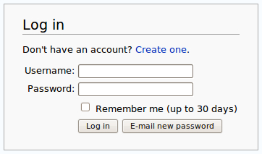
Example: Login
“Users” table with “username” and “password”
String sql = “SELECT * FROM Users WHERE username=‘”+ username + “’ and password=‘” + password+”’”;
the variables “username” and “password” contain data from user inputs
If query result is not empty, then the given user for that username is authenticated
This works, but can you see the problem here?

Slide 6
SQL Injection: Tautologies
Eve wants to login as Alice, but she does not know the password
Not a problem! Can inject a tautology with the password, eg “whatever’ or ‘1’=‘1”
note the first ‘ after “whatever”, and last string for 1 missing the closing ‘
The resulting SQL would become: “SELECT * FROM Users WHERE username=‘Alice’ and password=‘whatever’ or ‘1’=‘1’;
The WHERE clause would always be true (ie, a tautology)

Slide 7
SQL Injection: Cont.
Injection is the most common type of security vulnerability
See Top 10 from www.owasp.org
Problem: creating SQL commands by concatenating string without sanitizing user inputs
can alter the structure of the SQL queries
non-escaped single quote ‘ was the problem in previous example
this is the same kind of issue as in XSS attacks
SQL Injection allows attackers to access data without authorization by either turning the WHERE clauses into tautologies, or turn them in non-executed comments (--)

Slide 8
NEVER TRUST USER INPUTS!!!

Slide 9

Always Sanitize/Escape Inputs!
https://xkcd.com/327/

Slide 10
What info to steal?
Any sensitive data… but most commons are:
1) Credit Card Numbers
2) Passwords
Hacker can then login an impersonate a specific user
People often re-use the same password for different web sites

Slide 11
Passwords

Slide 12
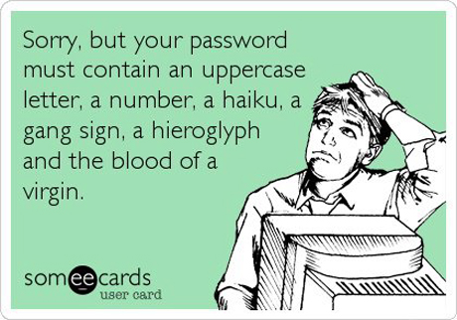
Passwords
Needed to verify identity of a user
Not too short nor simple, otherwise too easy to crack with brute-force
Security vs Usability: hard to get a good balance
eg, ideally would have different passwords for each different site, and change them often, eg every week… but who the heck is going to do that???

Slide 13
Password Storage
When creating new user, need to save password somewhere, usually a database
NEVER SAVE A PASSWORD IN CLEAR TEXT
Passwords need to be hashed
Even if an hacker has full access to database, should NOT be able to get the passwords
Typical case is a successful SQL Injection attack
But many more cases: eg disgruntled employee, recovery from broken thrown away hard-drive, etc.
Besides being able to impersonate a user, hacker can try the same password on other sites (Amazon/Facebook/etc)

Slide 14
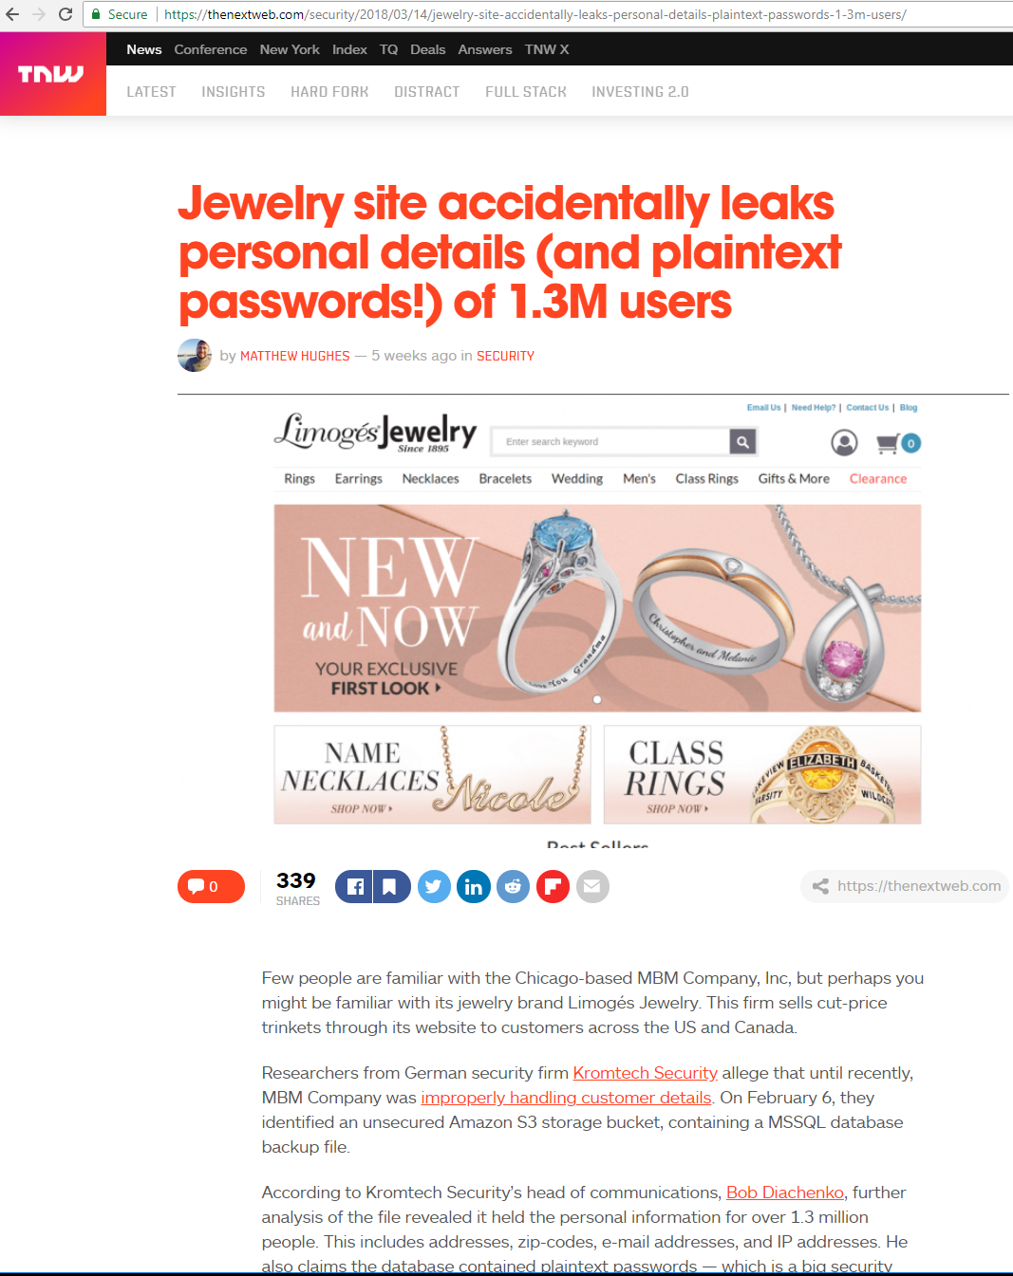
Thousands of examples…
Eg, 2018, 1.3 million plain-text passwords leaked from a web jewelry store
On a different topic, look at the “shares” icons, and how such companies can keep track of me visiting that page…

Slide 15
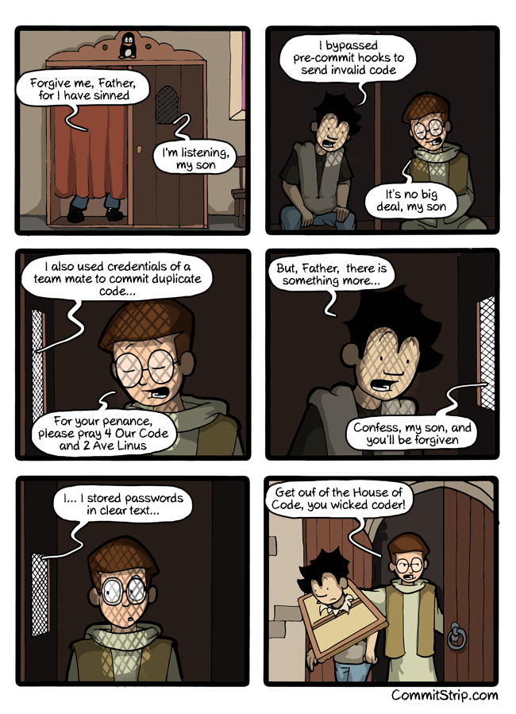
NEVER SAVE A PASSWORD IN CLEAR TEXT!!!
If password is “foo123”, then such string should NEVER be saved in the database
But how to do authentication then?

Slide 16
Hash Functions
h(x) = y
It is just a mathematical function from x to y
In our case, x is the password, and y is its hashed value
Deterministic: always same y from same input x
Shouldn’t be able to recover x from y, even if you have full knowledge of how h() is implemented
Small change x’ to x should lead to big different between y and y’
ie, y and y’ should look uncorrelated, and so cannot say if x and x’ are similar
For security, want no collisions: no two values should have same hash, ie h(x) = y = h(z)

Slide 17
h(“foo123”) = “fghtlZDaq”
Should not be possible to recompute “foo123” if a hacker knows “fghtlZDaq”
Set of Passwords
Set of Hash Values
foo123
h(“foo123”)
fghtlZDaq

Slide 18
Login with Hashed Passwords
How can server verify the login of user A with password X, if the server does not know the password X, but only the hash Y=h(X)?
Server needs to retrieve from database the hash Y for given user A, recompute the hash h(X) from the input password X, and then verify that the new hash does match Y, ie Y == h(X)

Slide 19
Logging in with foo/whatever would fail, because h(“whatever”) != “fghtlZDaq”
Logging in with foo/foo123 would work, as h(“foo123”) == “fghtlZDaq”
Database table for Users
UserName | Hashed Password
… | …
foo | fghtlZDaq
… | …

Slide 20
Salted Passwords
Cannot expect users to have long passwords
If hacker has access to DB, from a hash Y, can calculate h(K) for all strings K up to certain length N, eg N=8, and check if any h(K) does match Y
For small N, this is doable. Do not even need to run h(), as those values can be pre-computed, ie Rainbow Tables
Further issue: two users with same passwords will have same hash Y
Solution: add a random salt S (eg a random long string) to the password before hashing, and store the salt together with the hash in the database
h(X+S)=Y
Each user will have its own random salt

Slide 21
Both users foo and bar have the same password foo123
The hashed values are different, because the salt is different
h(“foo123SGFNSDSasdfs”) == “sfdsgIIl”
h(“foo123dsfsfewaaa”) == “Hnjnvrs”
Database table for Users
UserName | Hashed Password | Salt
… | … | …
foo | sfdsgIIl | SGFNSDSasdfs
bar | Hnjnvrs | dsfsfewaaa
… | … | …

Slide 22
Pepper
If hacker has access to the database, s/he can read the salt values
Still non-trivial to break the hash code, but doable
Pepper: yet another random string added before calculating the hash
NOT stored in the database, just somewhere else
files, remote server, hardcoded in the source code, etc
One single pepper string for whole application (and not per user)
Help mitigating if hacker gets access to the database (eg via SQL Injection), as would not be able to read the pepper

Slide 23
Hash Function Speed
In security, you want hash functions that are slow, to make it difficult for the hackers to break them
but still manageable time on server to do authentication, eg within 1 second
BCrypt is the most used hash function for passwords
However, you can make slow any hash function (eg SHA256) by using a loop, in which the output is re-hashed N times
eg, N=6 and so h(h(h(h(h(h(x)))))) = y
Note, SHA stands for Secure Hash Algorithm, but it is not really secure on its own, as too fast

Slide 24
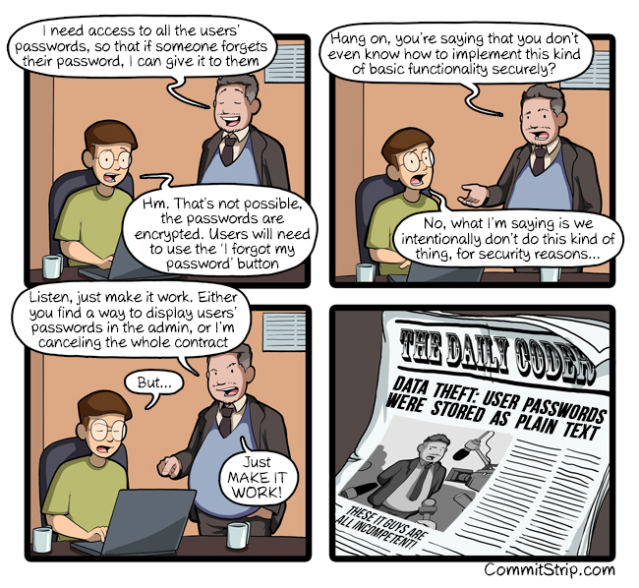
Implications of Hashing
A web site should not be able to tell you what was your password
If can give it to you, or even just some hints (eg first 2 letters), or tell you if too similar to a previous password, then BE WORRIED…
Note: comic has a mistake… passwords must be hashed, and NOT encrypted

Slide 25
Password Recovery
Should NOT be possible to recover a password
If one forgets it, can have a password reset
Email sent to user, with link to create a new password
This is a typical approach, but only works as long as email is not compromised

Slide 26
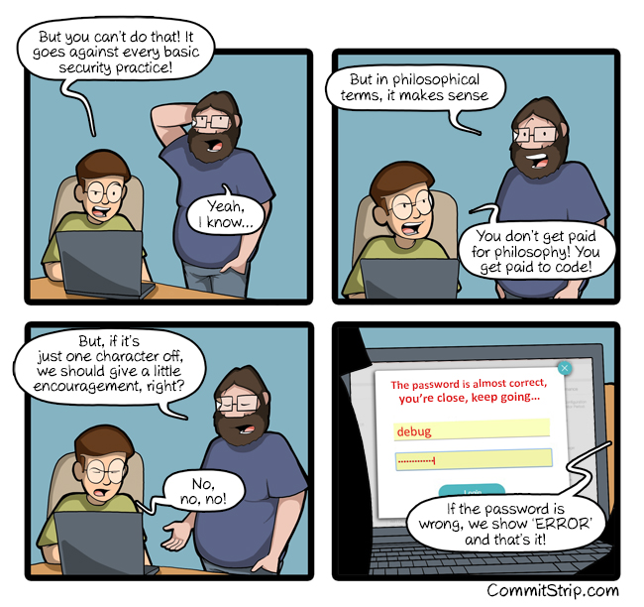
Failed Login
A failed login should not provide any further info
Eg, should not tell if password is close to correct one, or if user even exists
No unnecessary info should be leaked, as hacker could use it
Example: if user does not exist, still need to compute hash for password… why???

Slide 27
Cont.
Assume login with foo/foo123
Assume user foo does not exist
Computing hash h(“foo123”) takes time, so one could just immediately state tht login did fail, as foo not in the database
Computing h(“foo123”) would be a waste of CPU time, but still necessary
Recall, h() is slow
If not computing h(), then login for non-existing users would be much faster, and hacker can use such info to determine if a user exists
i.e, check how long it takes for server to state failed login
i.e., leaked info based on response time of the HTTP requests

Slide 28




Logging HTTP(S) Requests
Not uncommon to “log” events in a web server
eg, for debugging purposes, to see how users interact with the web application
What is the “security” problem here?
HTTP(S)
Requests
Save requests
to log files (or DB)

Slide 29
Passwords in logs not hashed!!!
2018: actually happened at GitHub and Twitter
When doing logging of HTTP requests, should remove/filter out data of passwords
HTTPS Encryption, but password not hashed
To process the HTTPS request, need to be decrypted first
Password not hashed, as that is done after the HTTPS request is handled
Passwords hashed when stored

Slide 30
For Next Week
Book pages: 41-42, 137-138, 372-377, 417
Note: when I tell you to study some specific pages in the book, it would be good if you also read the other pages in the same chapter at least once

